Slide 1
Changing Tides
Exploratory Climate Change Simulator
Fred Buchanan, Sam Cohen, and Myles Chiarello

Slide 2
An Incomprehensible Problem.
Climate Change often seams remote and academic.
“Changing Tides” allows people to experiment with Climate Change.
Adjustable Carbon Emissions.
Visualize temperature changes.
Visualize land lost to sea rise.
This empowers Learning by Doing.

Slide 3

The Model
Magicc
Simple climate model.
Developed by the National Center For Atmospheric Research and Manchester Metropolitan University.
Uses a “simple global average energy-balance equation”
Coupled with carbon cycle on ocean upwelling models.
Carbon Data
Annual emissions are from the “Monthly Energy Review” from the EIA.
Only large carbon values are selected by users.
Everything else is in Miscellaneous Emissions.

Slide 4
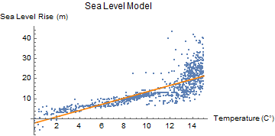
The Model Continued
Sea Level
Based on a simulated dataset.
Created for “Cenozoic global ice-volume and temperature simulations with 1-D ice-sheet models forced by benthic d18O records”
Fetched from Wolfram Datasets.
Linear over desired range.
Wolfram Mathematica was used to fetch and fit the model.

Slide 5



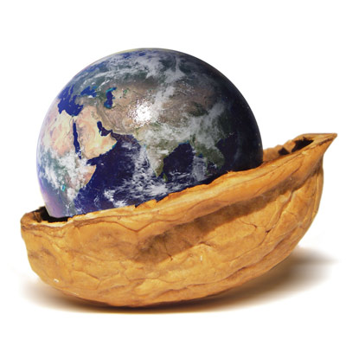






Architecture
Client
Server
Data
Magicc

Slide 6
DEMO!

Slide 7
The Future (if it’s not under water)
Better understanding of models.
More Robust UI.
More Greenhouse Gases.
Decay and Growth of Carbon Emission.

Slide 8
Citations
M. Meinshausen1, S. C. B. Raper2, and T. M. L. Wigley3. "mulating coupled atmosphere-ocean and carbon cycle models with a simpler model, MAGICC6 – Part 1: Model description and calibration". (2011, February 16)
Robert Gieseke, Zeb Nicholls, Jared Lewis, Sven Willner, & Matthias Mengel. "openclimatedata/pymagicc: v1.3.2 (Version v1.3.2)." (2018, October 15). http://doi.org/10.5281/zenodo.1462562
U.S. Energy Information Administration. "Monthly Energy Review." (2019, February 25).
de Boer, B., van de Wal, R.S.W., Bintanja, R., Lourens, L.J., Tuenter, E. "Cenozoic global ice-volume and temperature simulations with 1-D ice-sheet models forced by benthic d18O records", Annals of Glaciology, 51 (55), 23-33, 2010
Wolfram Research, "Sea Level and Temperatures Over the Last 40 Million Years" from the Wolfram Data Repository (2019) https://doi.org/10.24097/wolfram.90759.data

